Slide 1


CSCI-GA- 3033-010 – Cloud Computing Course Project 1:
Archemy Application Cloudification/Migration
Team:
Aishwarya Deokuliar
Arunachalam Muthupalaniappan
Daffney Deepa Viswanath

Slide 2
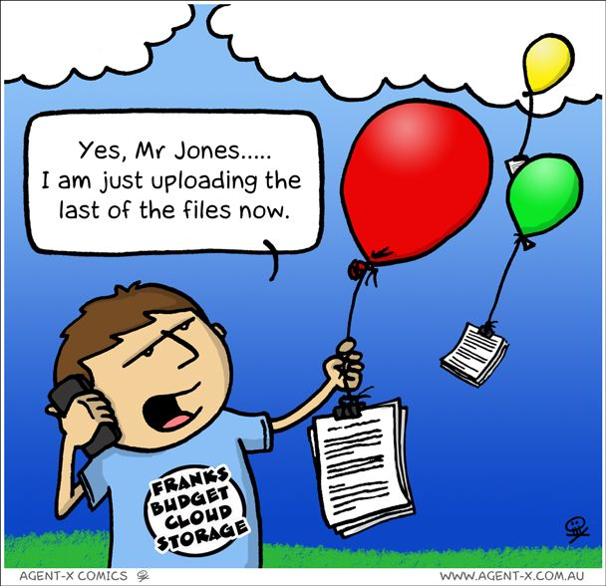
Table of Contents
Local Installation of the Application
Cloudification/Migration of the Application
Problems/Challenges faced

Slide 3
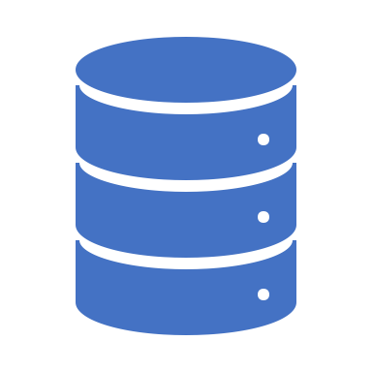
About the Application
The Application has 4 components,
LDAP Server- Apache DS (Authentication)
Tomcat Server- Fortress Core (Fortress WEB and Fortress REST) ( Security)
MySQL Database (Database)
Archemy webapp ( Application)

Slide 4
1. Local Installation of the Application
Step 1: Installing Software Requirements
Java SE Development Kit | Oracle ADF
MySQL Workbench | Maven
MySQL Connector (Java) | Cygwin
jDeveloper | wget and git packages (for Cygwin)
WebLogic (integrated with jDeveloper) | Fortress
Glassfish Extensions (for jDeveloper) | ApacheDS
Oracle ADF Essentials (for Glassfish) | Apache Directory Studio
Glassfish | Tomcat
Setting up and integrating software
Deploying application
Installing software

Slide 5
STEP 2 : SOFTWARE SETUP AND INTEGRATION
Setup ArchNav Database
Configuring Glassfish
Import ApacheDS Schema
Integrate ApacheDS with Apache Fortess core
Deploy fortress rest and fortress web to Tomcat

Slide 6


STEP 3 : DEPLOYING ARCHNAV
1.Build and Deploy ArchNav Security Application: build archemy security jar file. Next, integrate the jar file with glassfish
2. Configure Fortress to Include ArchNav Authentication and RBAC Details
3.Build the ArchNav application jdeveloper:- An application (.ear) file will be generated
4. Deploy the application to glassfish : We will deploy the ear file we created above in glassfish
5.Finally we test the application.

Slide 8
2. Cloudification/Migration of the Application
Approach:
Each component was made work in local and then was containerized.
Why Containerize?
Light weight, they share resources without a full OS to underpin each app
Platform Independence
Ability to move from one cloud to another

Slide 9

A. Containerization:
The Archemy Application is deployed in 3 containers
One for Tomcat Server housing fortress web and fortress rest
One for LDAP Server
Glassfish Server housing the Archnav Application
For MySQL Database - AWS RDS( Relational Database Service )

Slide 10
LDAP Server- Apache DS
Base image with Apache DS pulled from Dockerhub
Tomcat Server:
Pull Tomcat 8.5 base image from Dockerhub
Docker file created with tomcat startup script ( Catalina.sh), add fortress web and fortress rest application
Run the docker file

Slide 11
MySQL- AWS RDS:
Created a Database in AWS RDS
Established connection to MySQL Workbench
Import Stored procedures
Create Archemy Database user
Import ArchNav Data to populate the tables in the schema.

Slide 12
Glassfish Server:
Centos Base Image
Install Oracle Java 8.251
Download and install glassfish 5.0.1 from Oracle
Set up Environment Variable and Environment PATH
Update domain.xml (domain.xml + other configurations to support Oracle ADF)
Add ADF Essentials libraries
Add Archemy fortress security dependencies libraries
Add JDBC Dependencies libraries
Add archemy.ear file from the locally installed application
Run the docker

Slide 13

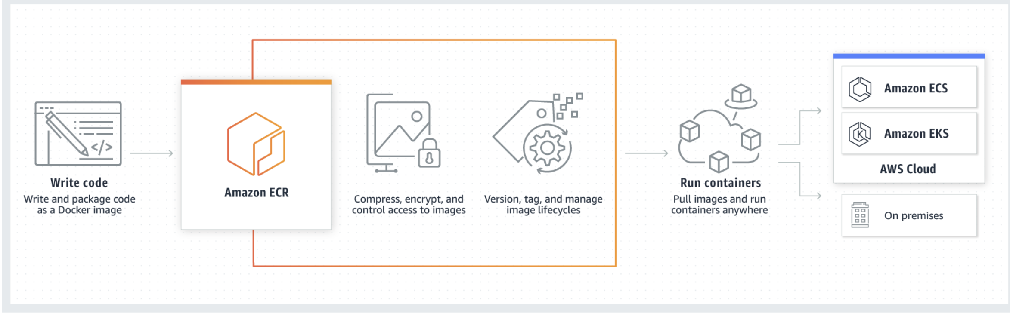
B. Cloudification:
Approach: Amazon Elastic Container Service, Amazon Elastic Registry
3 Repositories were created to host the docker container images for each of the Server, namely Tomcat/Fortress, ApacheDS and Archnav/Glassfish
Run the containers on Amazon Elastic Container Service
Create a ECS cluster.
Set up task definitions for ApacheDS,Tomcat & Archnav containers( Blue print of how to run the application )
Create Task in the ECS Cluster and define the number of tasks(1).

Slide 14
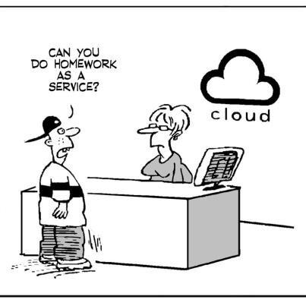
Problems/Challenges Faced
Glassfish Server
Version Incompatibilities
Jdeveloper version and Oracle ADF version should match
Oracle ADF libraries without nested directories
Cannot open the admin console in Remote login.

Slide 15
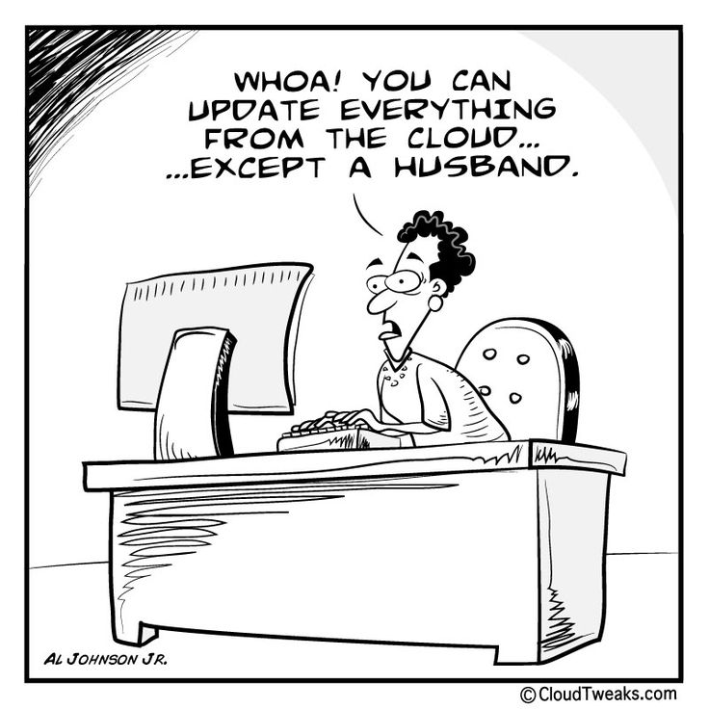
Problems/Challenges Faced
Tomcat – Fortress
Understand how the Fortress thing works
Update Fortress.properties with the correct LDAP server host/port
Update the catlina.sh to add the JAVA_OPTs for fortress

Slide 16
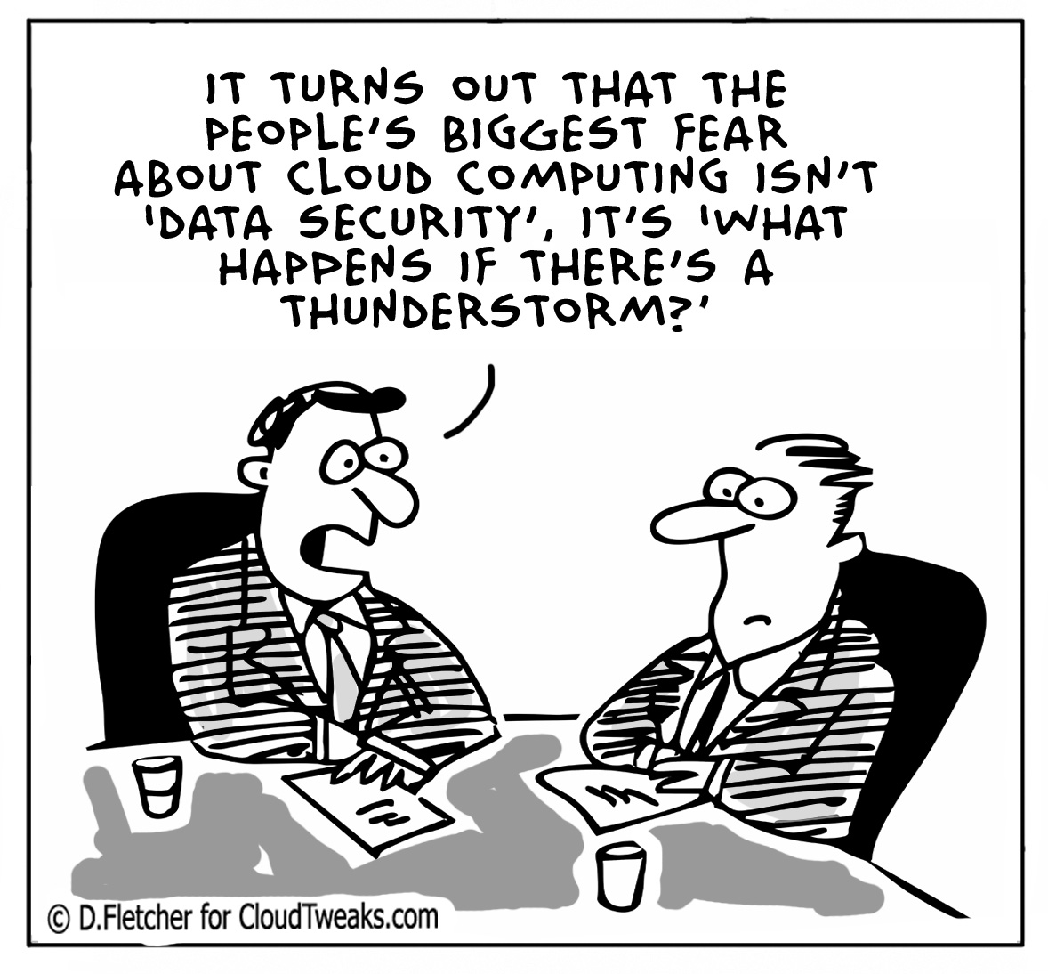
Problems/Challenges Faced
ApacheDS
the fortress ldif file has to be loaded, and the maven setup of fortress web and rest has to be completed again
MySQL
RDS does not allow a DEFINER syntax

